Slide 1
ROI SYSTEMS
Web Masters LLC
EsoTrade
Every number that matters for how you trade. One score. You approve every order.
Market intelligence terminal for stocks, crypto, options and futures · made by Harrison Holt · licensed to Web Masters LLC
Notes:
Open with the promise: one screen, one score, and the trader stays in control of every order.

Slide 2
Traders juggle ten tabs and still guess
What a self-directed trader deals with today
1
Too many tools
2
Numbers that ignore your style
Charting site, options-flow service, on-chain dashboard, macro calendar and a spreadsheet — none of them talk to each other.
A scalper and a long-term investor see the same indicators, even though they hold trades for seconds versus years.
3
Predictions with no track record
4
Bots that trade for you
Forecasts are shown with no record of how often they were right.
Tools that place orders on their own, or keep your keys and data on someone else's server.
Notes:
Ask the prospect which of these four they feel most. Most say the first.

Slide 3
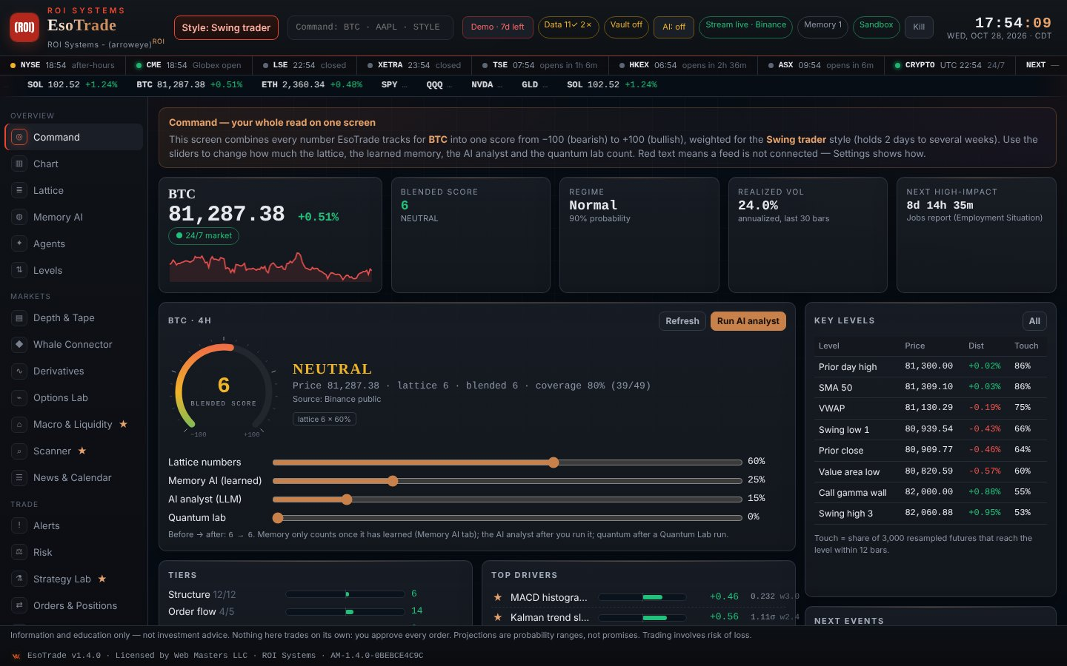
One screen, weighted for how you trade
Pick a style; EsoTrade loads the charts, numbers, scanners and risk for it
12 trading styles
Scalper to long-term investor, options, futures, forex, crypto spot, perpetuals and DeFi.
One score, −100 to +100
Every contribution shown, with sliders for the lattice, Memory AI, AI analyst and quantum lab.
Live data, no keys needed
Crypto, options, on-chain, US macro and headlines start immediately.

Slide 4
The lattice: 50 market numbers in six tiers
Structure · order flow · derivatives · on-chain & sentiment · macro & liquidity · AI & memory
50
6
5
12
market variables scored every refresh
tiers, weighted by your trading style
crypto exchanges with automatic fallback
trading styles to choose from
Memory AI saves every snapshot on the device and learns which numbers led price — but only uses what it learned when it beats chance on data it never saw.
Options lab: dealer gamma, gamma flip, max pain, 25-delta skew, put/call open interest and IV term structure.

Slide 5
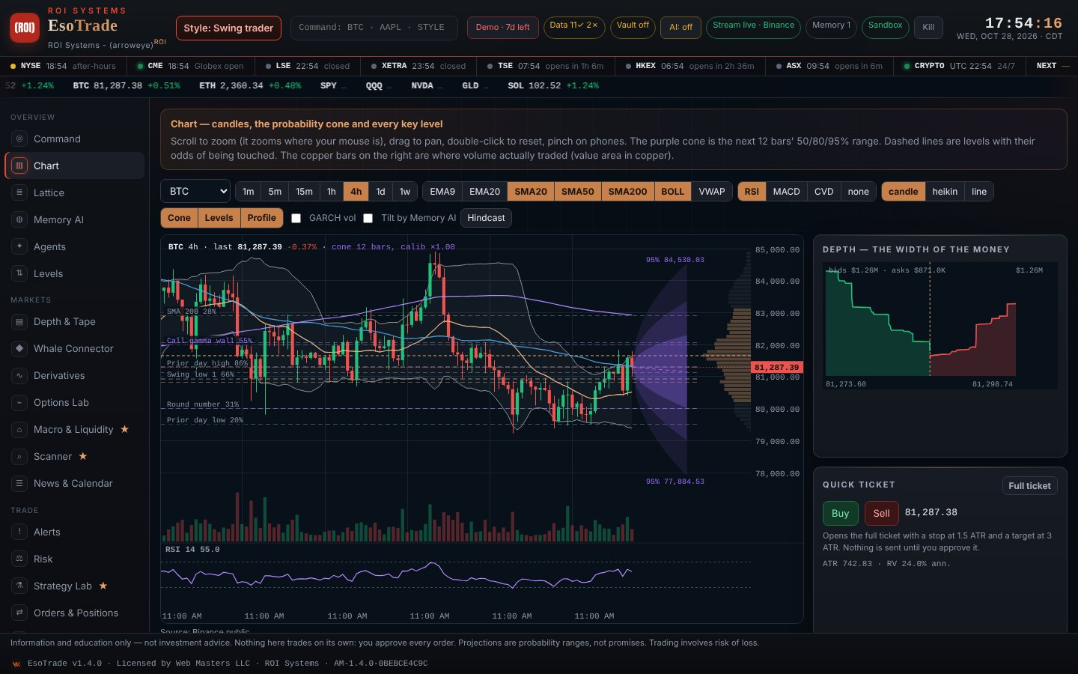
Projections with their uncertainty drawn on
The purple cone is the next 12 bars' 50/80/95% range, graded against what actually printed
Key levels with odds
Prior highs and lows, VWAP, gamma walls and round numbers, each with its chance of being touched.
Scorecard, not promises
Every projection is saved and checked; the app shows its own hit rate.
Pre-trade simulation
Monte Carlo of stop and target before you place a trade.

Slide 6
Your keys, your brokers, your wallets
Nothing depends on our accounts — every customer brings their own
1
Data keys in the app
2
Brokers
Paste free keys (Twelve Data, Polygon, Alpaca, FMP, Finnhub, FRED) and press Test.
Alpaca paper and live, Interactive Brokers through its own gateway, NinjaTrader signal files.
3
Wallets
4
Offline AI
MetaMask, Coinbase Wallet, Rabby, Phantom and more, plus watch-only addresses. Read-only.
Ollama runs the AI analyst on the customer's own computer, or they add a cloud AI key.

Slide 7
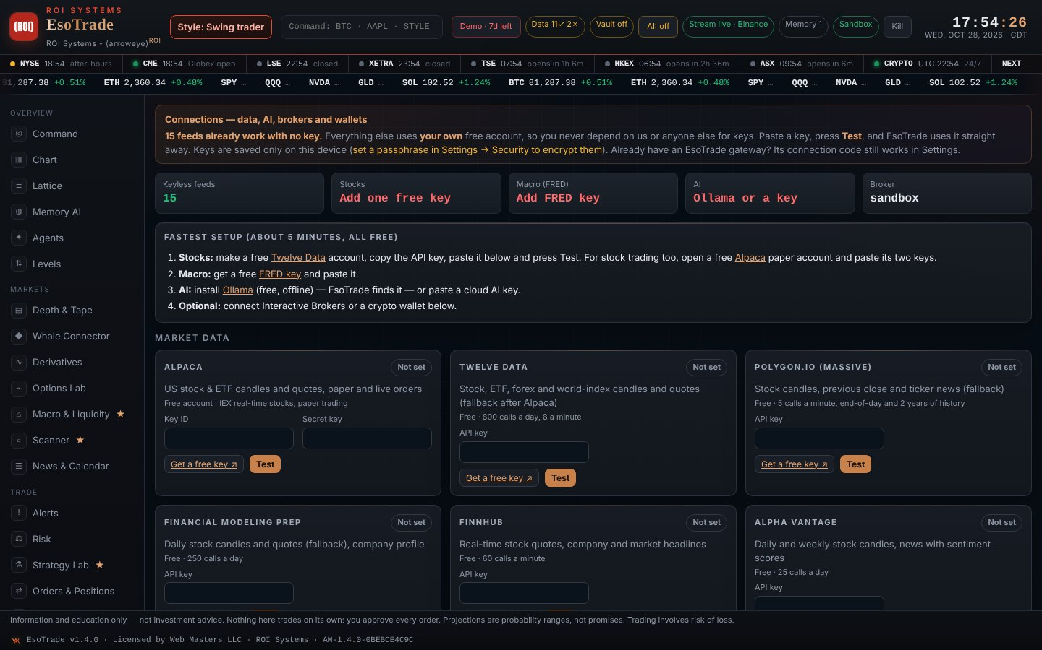
Built so the trader stays in control
Information and education — never automatic trading
Every order is approved by a person
Risk checks, daily loss limit and a kill switch
Tamper-evident audit log of every action
Data and keys stay on the customer's device
Signed build fingerprint on every copy

Slide 8
Try it free for 7 days
Open the demo in Chrome or Edge — it is the full app.
Buy a business license key: $99 for 30 days or $990 a year, with longer keys costing less per month. No automatic renewal.
Paste the key and everything you saved carries on.
web.arroweyesystems.com/p/esotrade · harrison@arroweyesystems.com · (501) 663-3200
Information, education and paper trading. Not investment advice. Trading involves risk of loss. Web Masters LLC · 700 S German Ln, Conway, AR 72034

